Slide 1

HARDWARE FUNDAMENTALS

Slide 2
Jabbireddy Gireesha (152659)
Introduction
Input devices
Soumya Gupta (152915)
Output devices
SMPS
Aastha Verma (152537)
Motherboard
Naredla Gangavamshi (152851)
CPU
Samiti Rahul (152907)
Memory

Slide 3
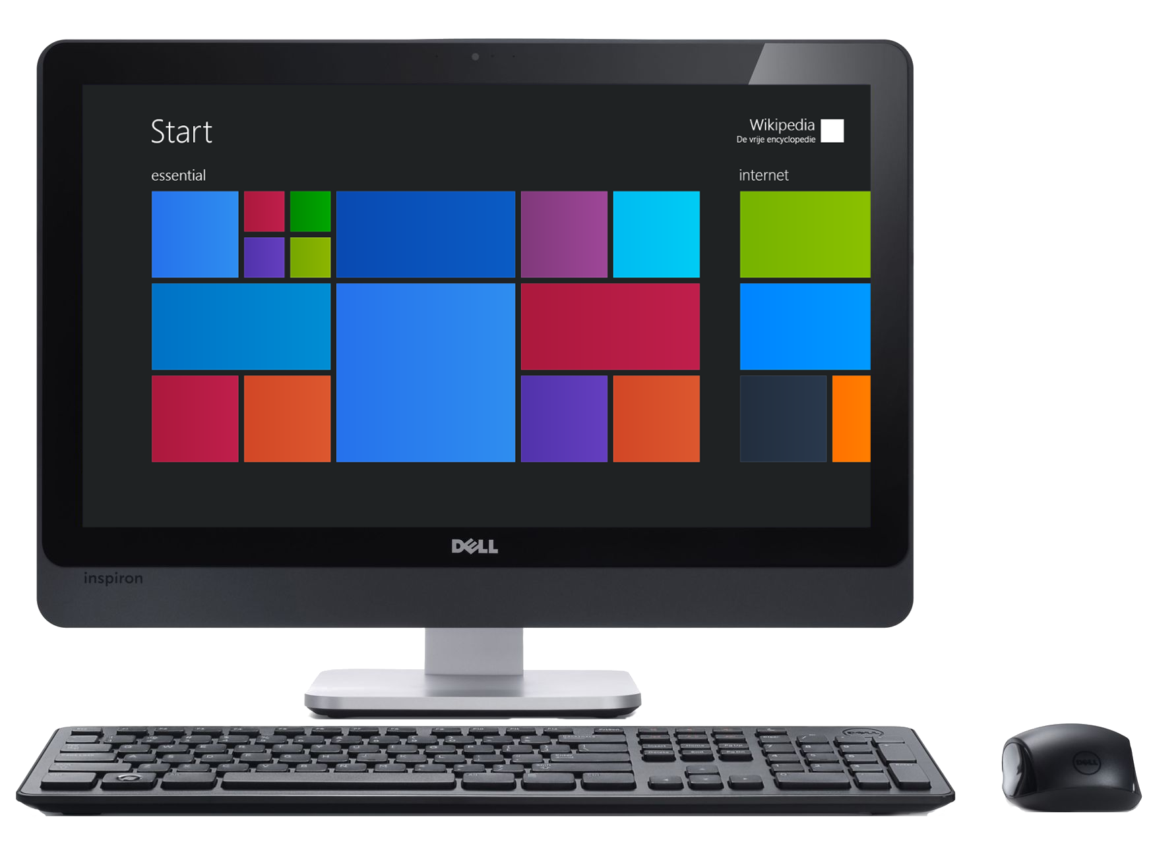

INTRODUCTION
Notes:
O Logo de espadas deve ter mais espaço das pontas abaixo. Sugerir outros tipos de imagens/ telefone, fones.

Slide 4
What is a Computer ?
A Computer is programmable machine. This means it can execute a programmed list of instructions and respond to new instructions that is given.
HARDWARE:
Hardware refers to the physical elements of a computer. This is also sometime called the machinery or the equipment of the computer.
SOFTWARE:
Software is any set of instructions that tells the hardware what to do and how to do it.
Notes:
O Box atras do texto desnecessario. Deixar o layout mais simples.

Slide 5
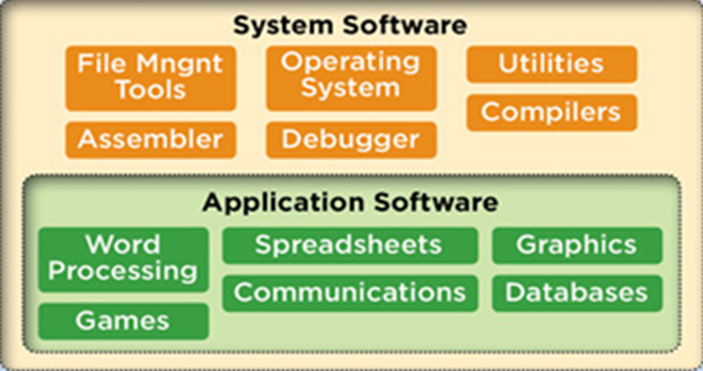
Types of Software:
1. System Software:
System software is computer software designed to provide a platform to other software.
2. Application Software:
An application is any program, or group of programs, that is designed for the end user.

Slide 6
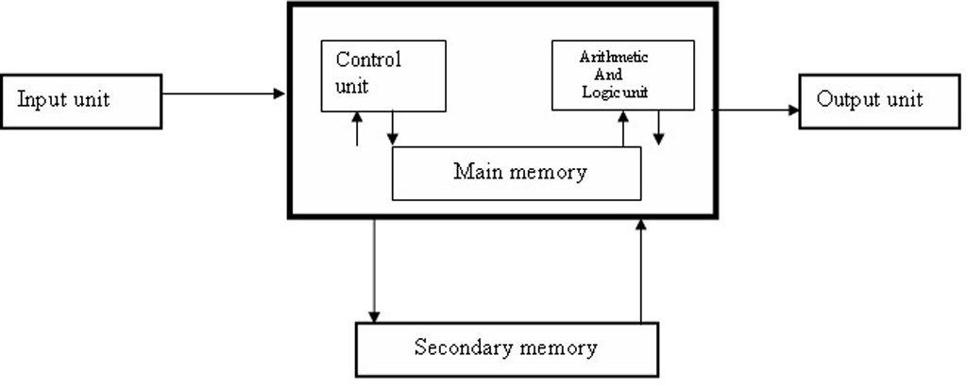
BLOCK DIAGRAM OF A COMPUTER

Slide 7
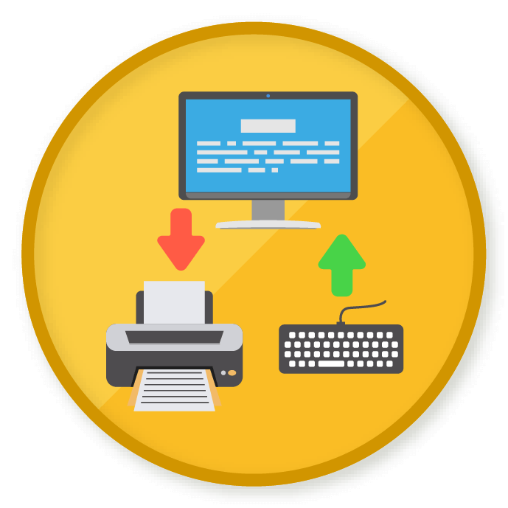
INPUT DEVICES
Notes:
O Logo de espadas deve ter mais espaço das pontas abaixo. Sugerir outros tipos de imagens/ telefone, fones.

Slide 8
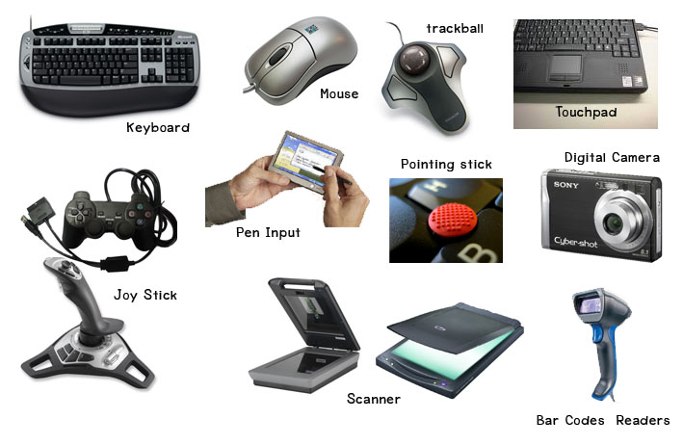
INPUT DEVICES

Slide 9
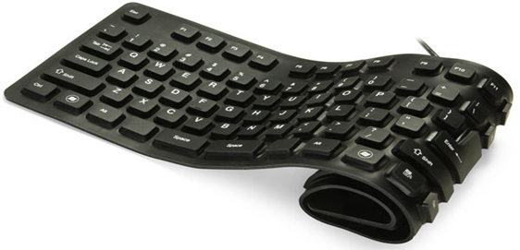
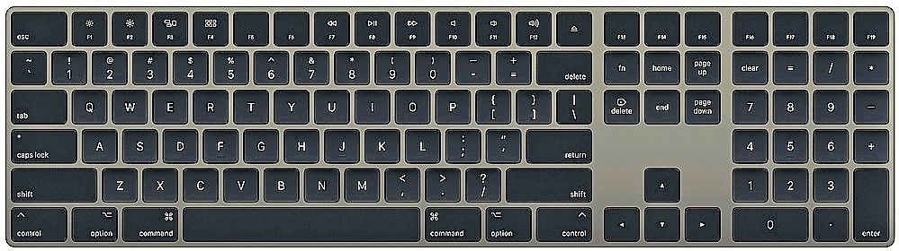
KEYBOARD
The keyboard is the piece of computer hardware used to input text, characters, and other commands into a computer or similar device.

Slide 10
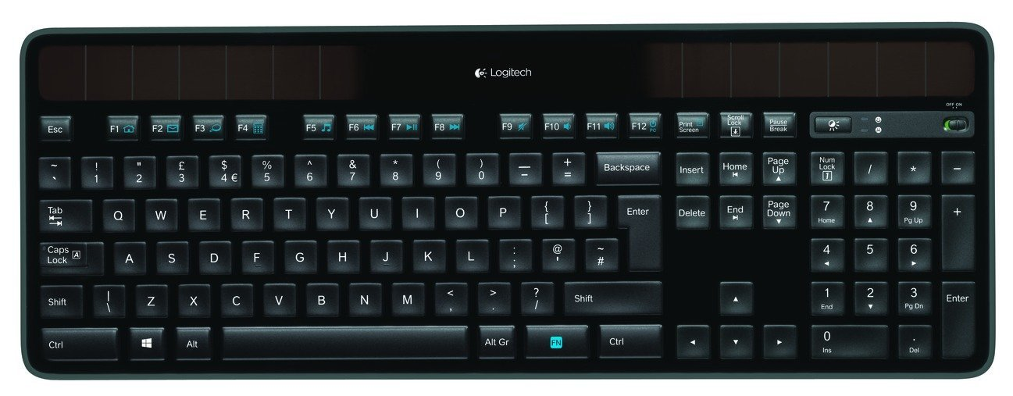
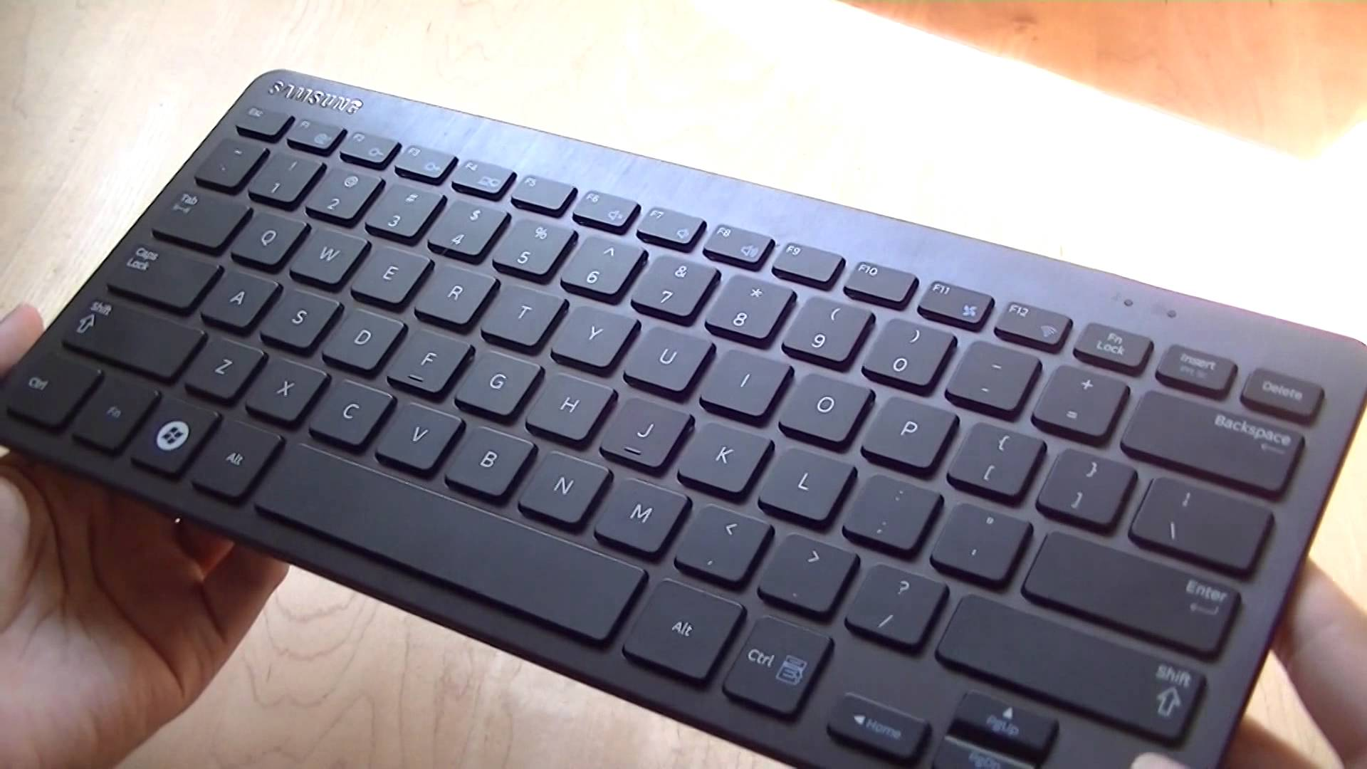
MECHANICAL KEYBOARD:
Mechanical keyboard uses actual, physical switches underneath the keys to determine when the user has pushed a key.
MEMBRANE KEYBOARD:
Membrane keyboard is a computer keyboard
whose "keys" are not separate, moving parts,
as with the majority of other keyboards,
but rather are pressure pads that have
only outlines and symbols printed on a flat,
flexible surface.

Slide 11
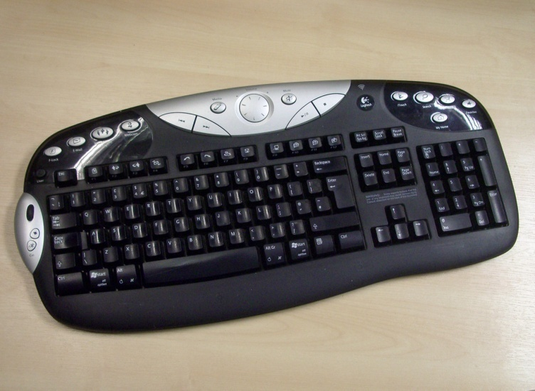
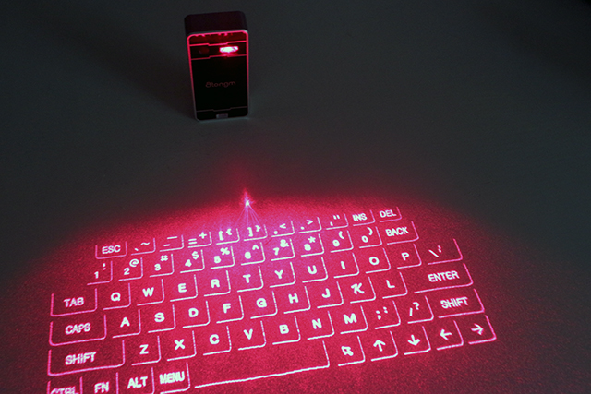
MULTIMEDIA KEYBOARD:
A Multimedia keyboard is one with media keys— additional buttons, typically along the top, for controlling audio playback, for starting common applications (e.g. e-mail client and Web browser) and other auxiliary functionality.
VIRTUAL KEYBOARD:
A virtual keyboard is a projection keyboard
that is projected on any flat surface.
Virtual keyboard uses sensor technology
and Artificial Intelligence to let user
works on plane surface.

Slide 12
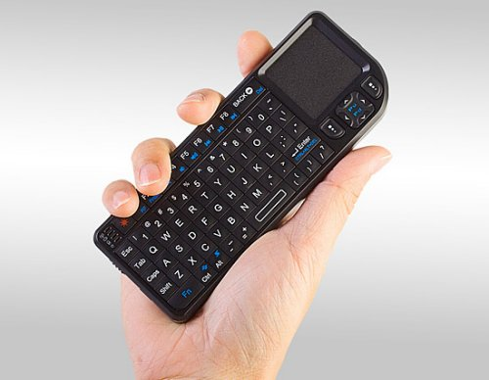
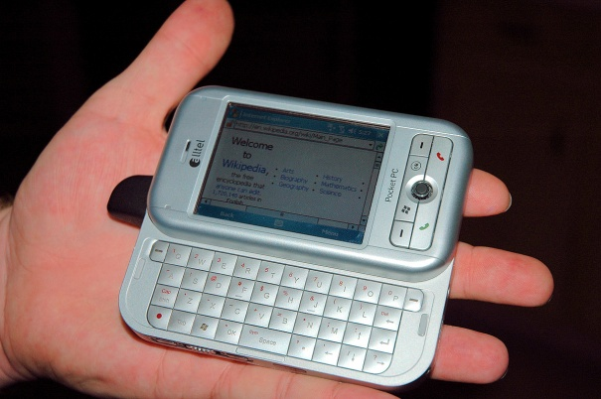
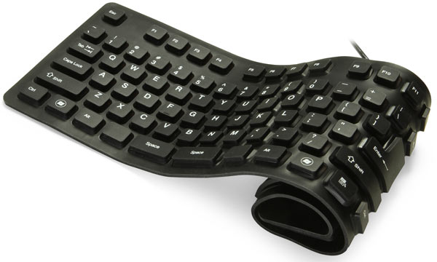
THUMB KEYBOARD:
A thumb keyboard, or a thumb board, is a type of keyboard commonly found on PDAs, mobile phones, and PDA phones which has a familiar layout to an ordinary keyboard, such as QWERTY
ROLL-UP KEYBOARD:
Keyboards made of flexible silicone or polyurethane materials can roll up in a moderately tight bundle.

Slide 13
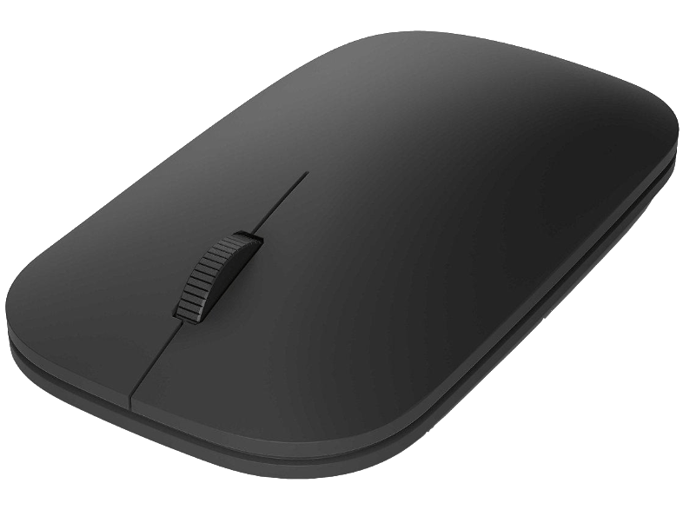
MOUSE
A computer mouse is a hand-held pointing device that detects two-dimensional motion relative to a surface. This motion is typically translated into the motion of a pointer on a display, which allows a smooth control of the graphical user interface.
The mouse was originally known as the X-Y Position Indicator for a Display System and was invented by Douglas Engelbart in 1963 while working at Xerox PARC.

Slide 14
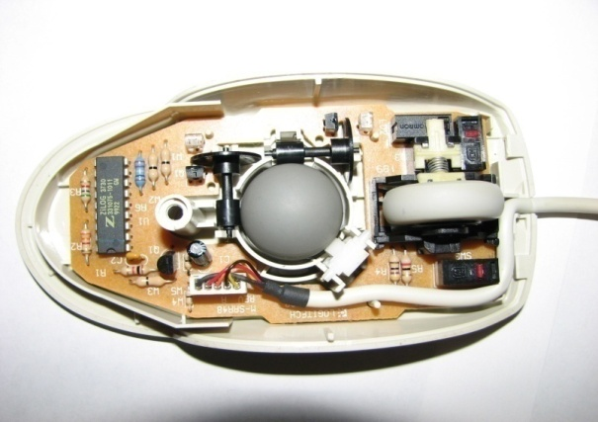
MOUSE TYPES
1. Mechanical Mouse
Bill English created a ball mouse in 1972
The ball mouse replaced the external wheels with a single ball that could rotate in any direction

Slide 15
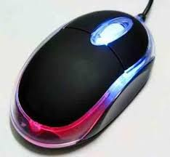
2. Optical Mouse
An optical mouse was developed in around 1980
Optical mouse make use of one or more light-emitting diodes (LEDs) and an photodiodes to detect movement relative to the underlying surface
It is unable to detect movement on surfaces like glass

Slide 16
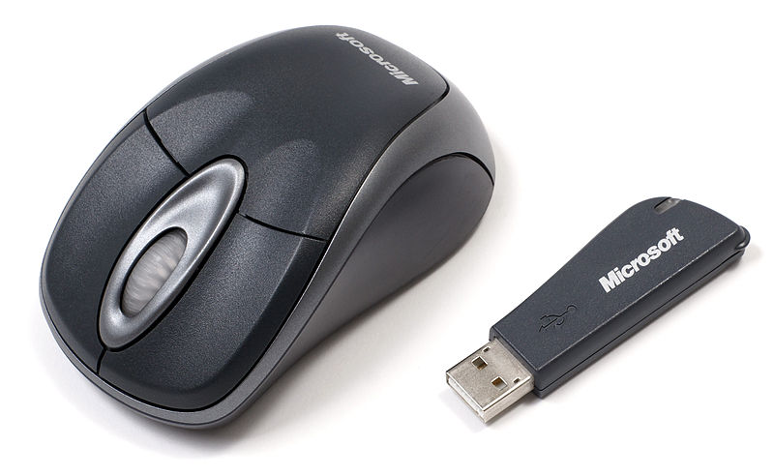
3. Wireless Mouse
Wireless Mouse does not consist of any cords to connect mouse to the PC.
Cordless or wireless mouse transmit data via infrared radiation or Bluetooth signals.
This consist of Transmitter and Receiver part connected trough wirelessly.

Slide 17
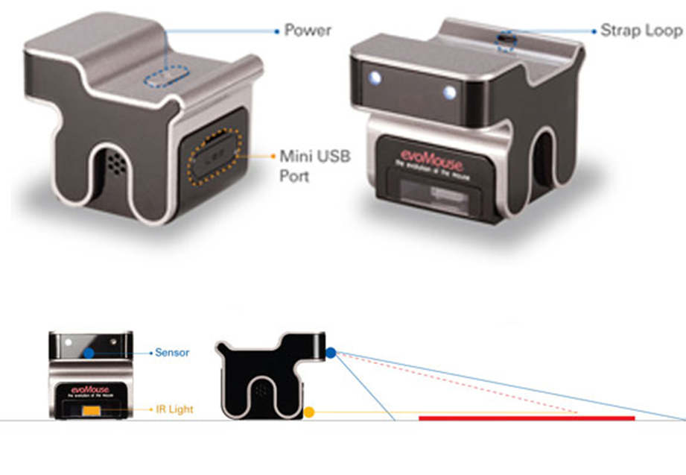
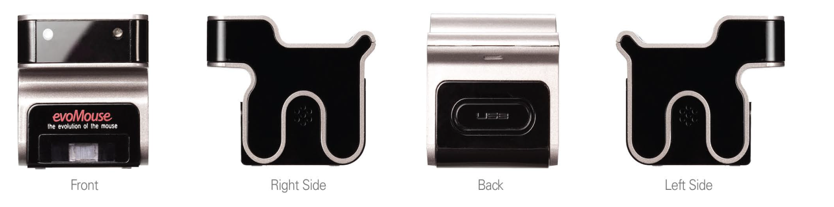
4. Evo Mouse
The Evo Mouse is the evolution of the computer mouse.
Evo Mouse is a dog – shaped device that functions differently and not like the other mouse.

Slide 18
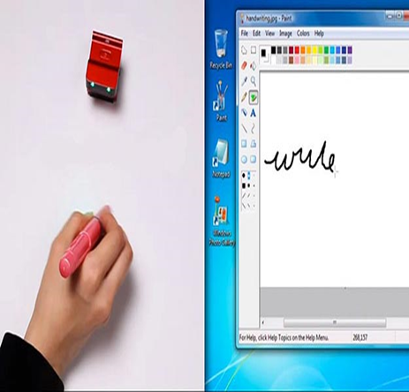
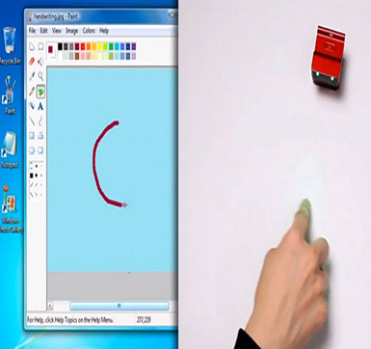
5. Hand Gestures

Slide 19
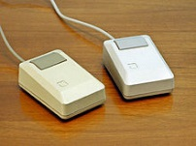
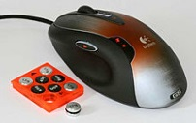
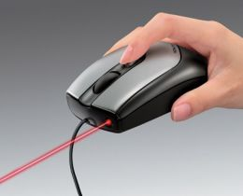
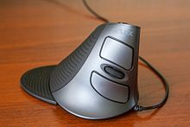
6. Other Mouse Variants :

Slide 20
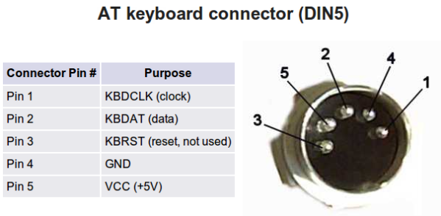
Types of Connectors
1. AT KEYBOARD CONNECTOR (DIN 5):
The 5-pin DIN (Deutsches Institut für Normung) connector was the first
widespread non-proprietary keyboard cable connector.
It was a bit larger than today's connectors, and had five pins which were
oriented asymmetrically to ensure a proper connection.

Slide 21
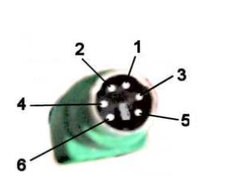
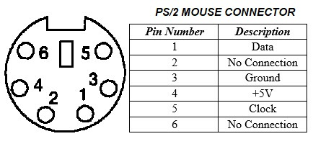
2. PS/2 (MINI-DIN6):
The 6-pin mini-DIN connector is a replacement for the original 5-Pin design.
This type of connector is often referred to as a PS/2 connector and is also
named for the IBM system that popularized it. This format is widely used
in desktop computers.
Color Coding :
Keyboard – PURPLE
Mouse - GREEN

Slide 22
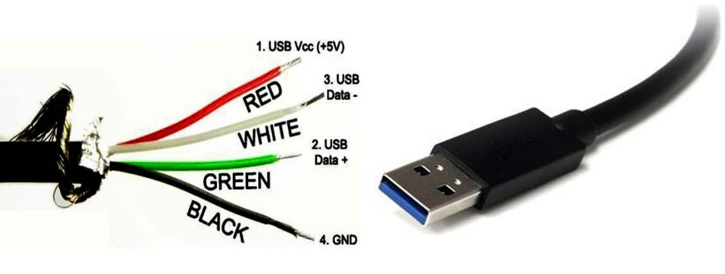
3. USB:
USB is an extremely common keyboard cable connector type.
This small rectangular connector provides a major upgrade over the DIN connector types.
AT and PS/2 devices are not hot-swappable.

Slide 23
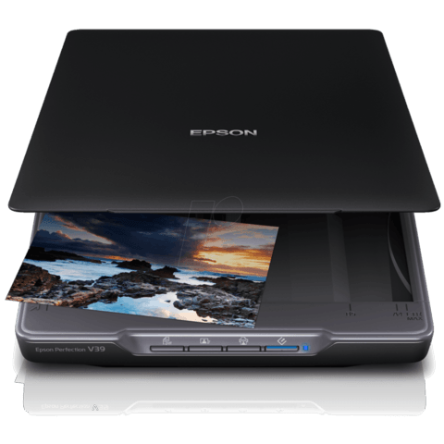
SCANNER
A scanner is a device that captures images from photographic prints, posters, magazine pages, and similar sources for computer editing and display.
Very high resolution scanners are used for scanning for high-resolution printing, but lower resolution scanners are adequate for capturing images for computer display.
Scanners usually come with software, such as Adobe's Photoshop product, that lets you resize and otherwise modify a captured image.

Slide 24
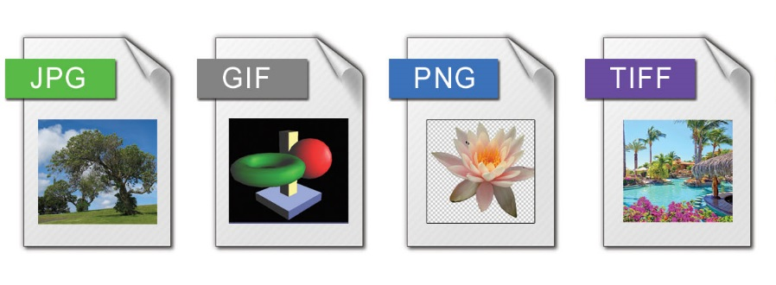
Scanning Formats:
Depending on your scanning software, you may have different options of file formats in which to save your scanned image or document.
Images may be saved as: jpg, bmp, tiff, or png.
Documents may be saved as: pdf, or any of the image formats.

Slide 25
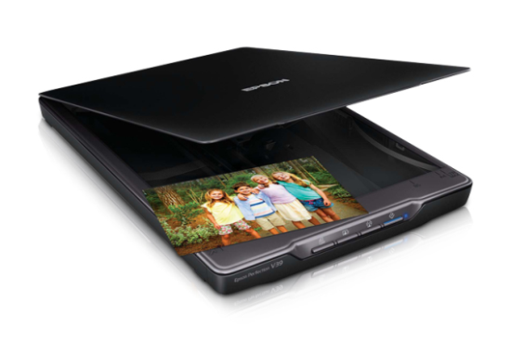
Types of Scanners
1. Flatbed Scanner:
A flatbed scanner is an optical scanner which makes use of a flat surface for scanning documents. The scanner is capable of capturing all elements on the document and does not require movement of the document.

Slide 26
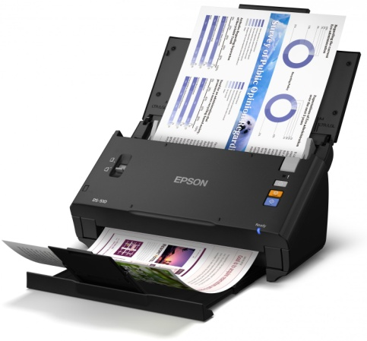
Types of Scanners
2. Sheetfed Scanner:
As its name suggests, in this type of scanner, the document is fed into the horizontal or vertical slot provided in it. While the sensor and source of light are stationary. Instead, the document moves through the scanner. These scanners cannot scan thick objects, like books.

Slide 27
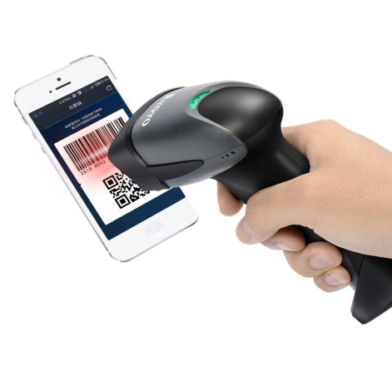
Types of Scanners
3. Hand-held Scanner:
A handheld scanner is a small manual scanning device which is moved over the object that needs to be scanned. Even a slight movement of hand can lead to distortion of the image. Hand held scanners are generally used with bar code technologies like library systems in schools.

Slide 28
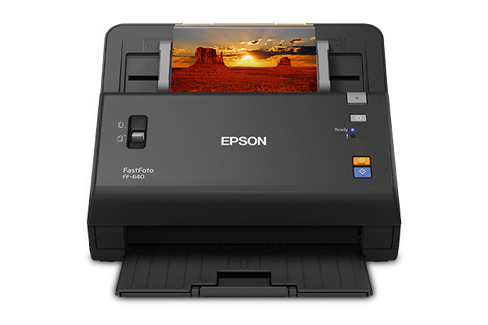
Types of Scanners
4. Photo Scanner:
As the name itself suggests, a photo scanner is mostly used to scan photographs. It boasts of high resolution and color depth, both of which are necessary for scanning photographs

Slide 29
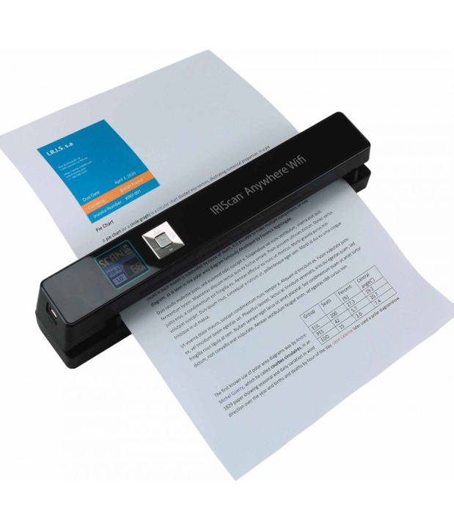
Types of Scanners
5. Portable Scanner:
Being small in size, portable scanners can be easily carried around. They are of great help when it comes to text document scanning. Their drawback though, is their limitation in terms of resolution.

Slide 30
OUTPUT DEVICES
Notes:
O Logo de espadas deve ter mais espaço das pontas abaixo. Sugerir outros tipos de imagens/ telefone, fones.

Slide 31
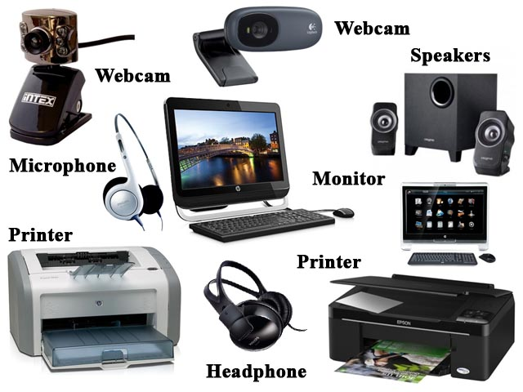
OUTPUT DEVICES

Slide 32
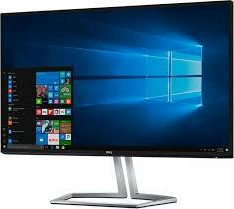
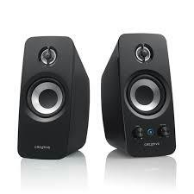
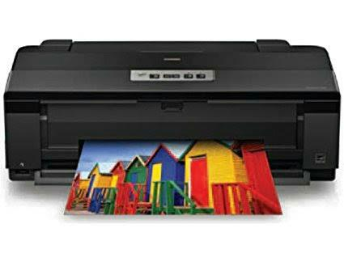
Output Devices
Any device capable of conveying information to a user.
Some output devices are :
Monitors
Printers
Speakers

Slide 33
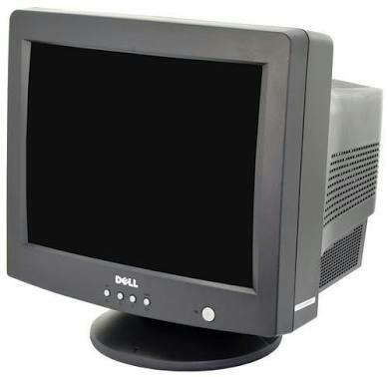
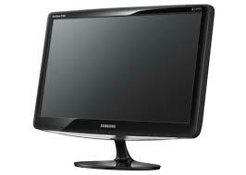
MONITOR
A display screen that provides a visual output .
Images are displayed on monitors by individual dots or picture elements called Pixels.
Types of Monitors :
CRT monitor
LCD monitor
LED monitor

Slide 34
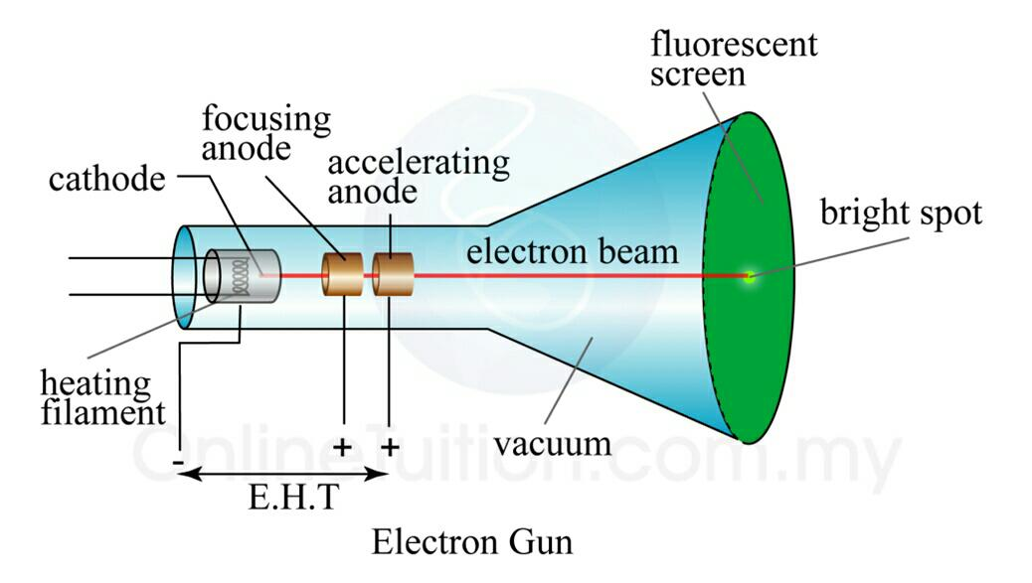
CRT monitors
Stands for Cathode Ray Tube monitor.
Electrons are fired on phosphorous dots on screen.
The dots are grouped into pixels, which glow when stuck by electrons.

Slide 35
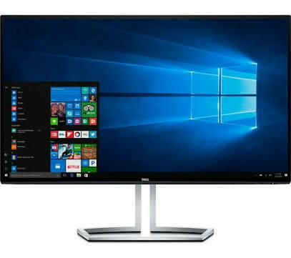
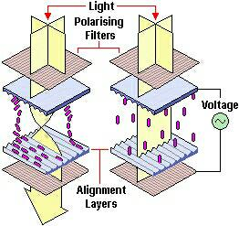
LCD monitors
Stands for Liquid Crystal Display monitor.
Thin, flat panel display device.
Polarization of lights is used to display object.
LCD displays utilize two sheets of polarizing material with liquid crystal solution between them.
An electric current passed through liquid crystal.
Each crystal either allow or block the light to pass through.

Slide 36
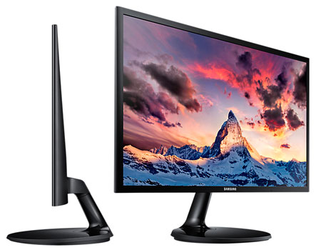
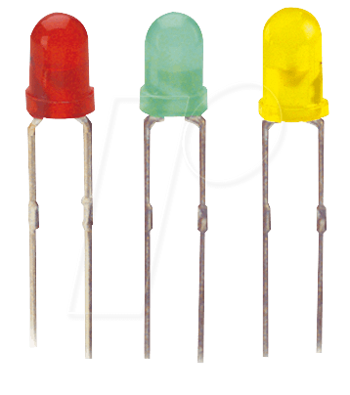
LED monitors
It is Light Emitting Diode (LED) based display.
It is flat panel display.
Matrix of diodes are arranged to form pixels and picture definition is stored in refresh buffer.
Information is read from refresh buffer and converted into voltage levels that are provided to diodes, thus providing light pattern in display.

Slide 37
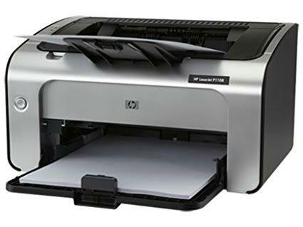
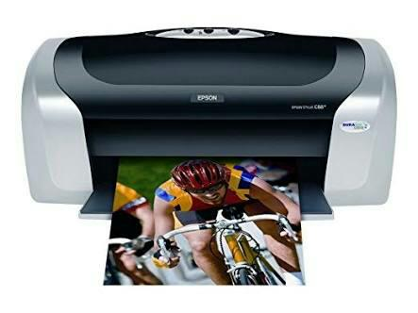
Printers
It is an output device that produce text and graphics on paper.
Some popular printers are :
Laser printer
Ink jet printer

Slide 38

Laser Printer
High speed high quality non-impact printer.
Uses laser beam to transfer images onto printer.
Instead of cartridges, laser printer use toner.
Printing resolution varies between 600-1200 dpi.

Slide 39

Laser Printer WORKING

Slide 40
Ink jet Printer
It is a non-impact printer producing a high quality print.
It has resolution between 300-600 dpi.
Ink jet printer sprays ink through small nozzles onto page to produce images.

Slide 41

Ink jet Printer WORKING

Slide 42

SMPS – Switched Mode Power Supply
Converts the unregulated AC or DC voltage to regulated DC voltage.
Work on the principle of switching regulation.

Slide 43

SMPS Connectors

Slide 44


Earthing
It is a process of connecting the dead part or live part of an electric equipment to earth is known as earthing
The main purpose is to minimize risk of getting electric shock or protect the system equipment and to provide effective return path from the machine to power source

Slide 45
How to Test Earthing
Portable Appliance Tester(PAT) is designed to test electrical safety and does all different tests necessary to ensure the electrical safety of the appliance and make testing easy
PAT does an earth bond or earth integrity test where as a millimeter does a continuity test

Slide 46

MOTHERBOARD
Notes:
O Logo de espadas deve ter mais espaço das pontas abaixo. Sugerir outros tipos de imagens/ telefone, fones.

Slide 47
CPU
and
power supply
What is a Motherboard ?
Motherboards provides the CIRCUITRY by which all parts of a computer communicate with each other
We install Motherboard inside the ‘computer case’.
Motherboard HOLDS all the components ranging from :
All peripherals and
Expansion cards

Slide 48


Slide 49

CHIPS : electronic interfaces through which the CPU, RAM, and input/output devices interact.
CHIPSETS : group of microchips to support the CPU’s interfacing with all the other devices on the motherboard.
2 subdivisions of chipsets :
Northbridge
Southbridge
Notes:
Usar para separador de capitulos . Seria bom ter esta versao em vermelho e verde tb..

Slide 50

NORTHBRIDGE :
Handles communication between CPU, RAM, Southbridge and high speed graphics ports (AGPs, PCIe)
Memory Controller Hub
SOUTHBRIDGE :
Manages the onboard peripherals (USB ports, PCI bus, LAN card, Hard Drives)
Input/Output Controller Hub

Slide 51


Snapshot of prominent Northbridge & Southbridge on the Motherboard.
But nowadays, Northbridge is coming integrated into the CPU.
TO SUMMARIZE :

Slide 52
Expansion Slots – to add additional functionality
SOUND
GRAPHICS
NETWORKING
USB Ports …etc
Expansion slot is a type of port or plug on a computer motherboard that allows devices or expansion card to attach to the computer and add new types of functionality to the computer.
Common Expansion Cards :
Graphics card (for connecting to a monitor)
Network card (for transmitting data over the network)
Sound card (for connecting to speakers and microphones)

Slide 53

Expansion Slots Types :
1. ISA
Industry Standard Architecture
Very Old ? => Then why it is still there on motherboard ? => LEGACY
Typically black
ISA slots have 2 different sized sections – speed scalability
Notes:
Fixar a posicao do titulo – sempre do lado esquerdo.
Sempre que tiver muito texto o coluna deve sempre ser “ narrowed” , se nao fica dificil de ler. Colocar paragrafos no texto.
Linha vertical deve ser mais fina e as pontas NUNCA devem ser arredondadas.

Slide 54

2. PCI
Peripheral Component Interconnect.
Older version of PCIe.
Developed by Intel as a faster alternative to the deprecated ISA bus.
Typically white in color.
Slot for older expansion cards such as sound cards, network cards, connector cards.
PCI bus has 32 bit and 64 bit variants:
Initially had 32 bit data path, and supported 5 volts of power.
Later enhanced to 64 bits and 3.3 volts.

Slide 55

3. PCI-X
Peripheral Component Interconnect EXTENDED.
PCI-X improved upon the PCI bus for use in servers.
Enhances the PCI standard with wider data paths & faster paths.
Typically implemented in servers with a need for higher performance.
Backwards compatible with PCI.
We had it on workstations but mostly it has been phased out.

Slide 56

4. PCI-E (PCIe)
Peripheral Component Interconnect EXPRESS.
Successor to traditional PCI bus but substantially faster.
Connects to either Northbridge or Southbridge.
Uses lanes : (Lanes are full duplex)
PCIe 1x
PCIe 4x
PCIe 8x ……. Least common
PCIe 16x …... Video Card
Physical slot size determines compatibility : 1x can go into a 1x size or larger
Format on Motherboard : PCIEX16

Slide 57



5. Mini PCI and Mini PCIe
Specifically for use in laptops.
This is used to add WIFI, Bluetooth and SCSI or similar functionality to laptops.
6. EISA slot
Extended Industry Standard Architecture.
Extends ISA from 16 bits to 32 bits.
Backwards compatible with ISA bus.
7. AGP slot
Accelerated Graphics Port.
AGP is an advanced port designed for video cards and 3D accelerators.
Developed by Intel, AGP introduces a dedicated point-to-point channel that allows the graphics controller direct access to the system memory.
The AGP channel is 32-bit wide and runs at
66 MHz.

Slide 58

Computer Ports
Serial Port
Parallel Port
USB Port

Slide 59



 | PORTS
 | SERIAL | 9 pin connector to connect serial mouse. Allow only 1 bit at a time. Used to connect communication device (COM Port). Maximum data rate is 115 Kbps.
 | PARALLEL | Allow 1 byte (8 bit) at a time. 25 pin female port to connect printer, scanner and external devices. It moves data at speed of about 1 Mbps.
 | USB | Universal Serial Bus. Supports upto 127 devices. Formerly with 1.2 Mbps, it was improved to full speed, 12 Mbps. (USB 2.0 – more than 400 Mbps)

Slide 60

BIOS
BASIC INPUT OUTPUT SYSTEM
During the startup process, information about the hardware is provided by a microchip on the motherboards called the BIOS.
It is a firmware – in between hardware and software.
BIOS is stored on ROM chips on the motherboard.

Slide 61
Working of BIOS
When we turn on your computer, the BIOS does several things (in sequence) :
Check the CMOS Setup for custom settings
Load the interrupt handlers and device drivers
Initialize registers and power management
Perform the power-on self-test (POST)
Display system settings
Determine which devices are bootable
Initiate the bootstrap sequence

Slide 62

BIOS Screen
To enter the CMOS Setup, you must press a certain key or combination of keys during the initial startup sequence. Most systems use Esc, Del, F1, F2, Ctrl-Esc or Ctrl-Alt-Esc to enter setup. There is usually a line of text at the bottom of the display that tells you Press ___ to Enter Setup.

Slide 63
BIOS Settings
Once you have entered setup, you will see a set of text screens with a number of options. Some of these are standard, while others vary according to the BIOS manufacturer. Common options include:
System Time/Date - Set the system time and date
Boot Sequence - The order that BIOS will try to load the operating system
Plug and Play - A standard for auto-detecting connected devices; should be set to "Yes" if your computer and operating system both support it

Slide 64
Mouse/Keyboard - "Enable Num Lock," "Enable the Keyboard," "Auto-Detect Mouse"...
Drive Configuration - Configure hard drives, CD-ROM and floppy drives
Memory - Direct the BIOS to shadow to a specific memory address
Security - Set a password for accessing the computer
Power Management - Select whether to use power management, as well as set the amount of time for standby and suspend
Exit - Save your changes, discard your changes or restore default settings

Slide 65

SIMM
SIMM (single in-line memory module) is a module containing one or several random access memory (RAM) chips on a small circuit board with pins that connect to the computer motherboard

Slide 66

DIMM
A DIMM (dual in-line memory module) is a double SIMM(single in-line memory module). Like a SIMM, a DIMM is a module that contains one or several random access memory (RAM) chips on a small circuit board with pins that connect it to the computer motherboard

Slide 67

DDR
Double data rate (DDR) is the advanced version of synchronous dynamic random access memory (SDRAM). SDRAM waits for clock signals before responding to control inputs. DDR uses both the falling and rising edges of the clock signal.
DDR transfers data twice per clock cycle

Slide 68

CPU
Notes:
O Logo de espadas deve ter mais espaço das pontas abaixo. Sugerir outros tipos de imagens/ telefone, fones.

Slide 69

Central Processing Unit
It is a brain of a computer
It performs all actions according
to set of instructions

Slide 70
Processor
Central Processing Unit Architecture operates
the capacity to work from “Instruction
Set Architecture” to where it was designed.
There are two architectural designs of CPU they are
RISC (Reduced instruction set computing)
CISC (Complex instruction set computing)

Slide 71

CISC
CISC has the ability to execute addressing modes or multi-step operations within one instruction set.
It is the design of the CPU where one instruction performs many low-level operations.
For example, memory storage, an arithmetic operation and loading from memory.

Slide 72
Characteristics of CISC
Instruction-decoding logic will be Complex.
One instruction is required to support multiple addressing modes.
Less chip space is enough for general purpose registers for the instructions that are operated directly on memory.
Various CISC designs are set up two special registers for the stack pointer, handling interrupts, etc.
MUL is referred to as a “complex instruction” and requires the programmer for storing functions.

Slide 73

RISC
RISC was designed with a strategy that simple instruction set gives higher performance when combined with a microprocessor architecture.
It has the ability to execute the instructions by using some microprocessor cycles per instruction.

Slide 74
Characteristics of RISC
Simple Instructions are used in RISC architecture.
RISC helps and supports few simple data types and synthesize complex data types.
RISC utilizes simple addressing modes and fixed length instructions for pipelining.
RISC permits any register to use in any context.
One Cycle Execution Time
The amount of work that a computer can perform is reduced by separating “LOAD” and “STORE” instructions.

Slide 75

Difference between RISC and CISC

Slide 76

Multitasking :
Multitasking, in an operating system, is allowing a user to perform more than one computer task.(such as the operation of an application program) at a time.
The operating system is able to keep track of where you are in these tasks and go from one to the other without losing information.

Slide 77

Multiprogramming :
Multiprogramming is a rudimentary form of parallel processing in which several programs are run at the same time on a uniprocessor.
Since there is only one processor there can be no true simultaneous execution of different programs.
Instead, the operating system executes part of one program, then part of another, and so on. To the user it appears that all programs are executing at the same time.

Slide 78

MultiThreading :
Multithreading is the ability of a program or an operating System Process to manage its use by more than one user at a time and to even manage multiple requests by the same user without having to have multiple copies of the programming running in the computer.
Each user request for a program or system service (and here a user can also be another program) is kept track of as a Thread with a separate identity. As programs work on behalf of the initial request for that thread and are interrupted by other requests, the status of work on behalf of that thread is kept track of until the work is completed.

Slide 79

HyperThreading :
Hyper-threading is a technology developed by Intel Corporation. It is used in certain Pentium 4 processors and all Intel Xeon processors. Hyper-threading technology, commonly referred to as "HT Technology," enables the processor to execute two threads, or sets of instructions, at the same time.
Since hyper-threading allows two streams to be executed in parallel, it is almost like having two separate processors working together.

Slide 80


MEMORY
Notes:
O Logo de espadas deve ter mais espaço das pontas abaixo. Sugerir outros tipos de imagens/ telefone, fones.

Slide 81

MEMORY & STORAGE
MEMORY : Provides your working space (Ex. RAM,ROM).
STORAGE : Provides capacity for all the files and information you need. (Ex: hard disk, Optical disk, USB).

Slide 82
MEMORY
The physical devices used to store the data either temporarily or permanently.
Data is stored in binary format.
Types :
RAM
ROM
Cache memory

Slide 83
RAM
Random Access Memory
Used as a temporary storage because it is volatile.
Allows the user to read or write the data at the same amount of time.
Types
SRAM
DRAM

Slide 84
SRAM vs. DRAM
STATIC RANDOM ACCESS MEMORY | DYNAMIC RANDOM ACCESS MEMORY
Semi conductor memory | Store each bit of memory in capacitor in an integrated circuit
Uses flip-flop to store each bit of memory | Uses a pair of transistor and a capacitor to store the data.
Need to be refreshed frequently. | Doesn’t required to refresh frequently.
6 transistors per bit | Single transistor per bit.
Faster and consumes less power. | Slower and consumes more power than SRAM.

Slide 85

Read Only Memory
A storage medium used to store the data permanently.
Mainly used for firmware, programs to start PC, Boot settings.
Types
PROM
EPROM
EEPROM

Slide 86

TYPES OF ROM
PROM
EPROM
EEPROM
Programmable ROM
It is empty when manufactured. This complete empty space can be used by the user and cant be erased once used.
Erasable PROM
Programmed with the use of very high voltages and exposure to approx. 20 minutes of intense ultraviolet (UV) light. The data in the chip can be erasable.
Electrically Erasable PROM
Same as EPROM, here the data can be erased electrically as many times according to the requirement.

Slide 87

CACHE MEMORY
Typically integrated directly into the CPU chip or placed on a separate chip that has a separate bus interconnect with the CPU.
Used to store program instructions and data that are used repeatedly in the operation of programs or information that the CPU is likely to need next.
Improves computer’s performance.
Types :
L1 : Primary cache
L2 : Secondary cache
L3 : Specialized cache

Slide 88

CACHE TYPES
L1: Primary cache
L2: Secondary cache
L3: Specialized memory
Extremely fast and small.
Usually embedded in the processor chip as a CPU cache.
Capacity: 8Kb-128Kb.
Slower than L1
Embedded on CPU directly.
Capacity: 64Kb-16Mb.
Slowest of all.
Developed to improve L1&L2 performance.
Separated from processor chip on the motherboard.

Slide 89

STORAGE
Notes:
O Logo de espadas deve ter mais espaço das pontas abaixo. Sugerir outros tipos de imagens/ telefone, fones.

Slide 90

STORAGE DEVICES
Any computing hardware that is used for storing, porting and extracting data files and objects even when the power is off.
Ex: Floppy disk drive, hard disk drive, USB flash disk,...
It can hold and store information both temporarily and permanently, and can be internal or external to a computer, server or any similar computing device.
Types :
Optical storage
Magnetic storage
Flash memory device

Slide 91



Magnetic Storage

Slide 92

Hard Disk Drive
First introduced in 1956
Max. capacity: 4 TB
Continuously improved.
Connected to systems by standard interface cables such as :
PATA (Parallel ATA)
SATA (Serial ATA)
USB or SAS (Serial Attached SCSI).

Slide 93
Floppy disk
A removable magnetic storage medium
First introduced in 1967
Read and written by Floppy Disk Drives(FDD)
Discontinued usage
Types :
8”
5.5”
3.5”

Slide 94





OPTICAL STORAGE
Compact Disc (CD)
Capacity: 700MB
Available from 1982
DVD
Capacity: 4.7 GB
Available from 1995
Blu-ray Disc
Capacity: 25 GB
Available from 2006

Slide 95

Flash Memory Devices
Developed in 1980.
Non-volatile storage medium that can be electrically erased and reprogrammed.
USB Flash Drive
Commercially available in 2000
Max. capacity: 1 TB.
Small in size
Ideal solution for storing data.

Slide 96

Solid State Drive
Introduced in 1995.
Max. capacity: 1 TB.
Very high transferring speed.

Slide 97

INTERFACE TYPES
Types of Hard Disk Interface
IDE
SCSI
SATA

Slide 98

IDE
INTEGRATED DEVICE ELECTRONICS
Floppy drive ,Hard drive ,CD-ROM drive Usually, these devices connect to the computer through an Integrated Drive Electronics (IDE) interface.

Slide 99



IDE SLOTS
IDE CABLES

Slide 100



Small Computer System Interface (SCSI)
SCSI Connector
SCSI types
SCSI Terminator

Slide 101


SATA
Serial Advanced Technology Attachment cable
These cables are known for transferring data at high rates (from 1.5 to 6 gigabytes per second)
The cable comes with a few specific purposes that are used by every computer for some form of data access.
The SATA cable is used so that a motherboard
can communicate with an internal hard drive,
but there are other devices that can
make use of the SATA cable as well.

Slide 102


